Slide 1
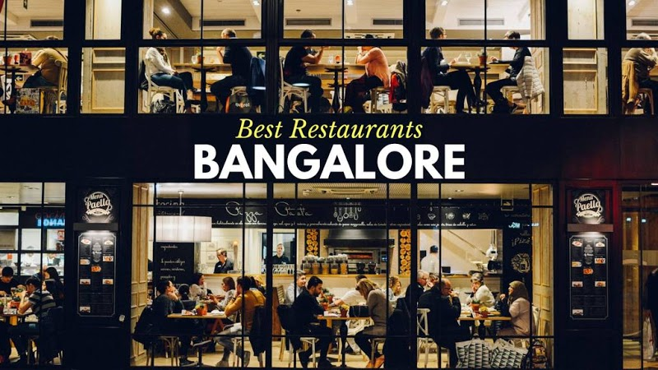
Analytical Solution – Restaurant a Banglore
Nikhil Darokar
WelCome

Slide 2
Agenda :
Introduction
Problem Statement
Problem Analysis
Solution
Impact

Slide 3
Introduction
A man has rented a shop near BTM Layout Nagar, The rent of his shop is 14000 per month.
In first three months he make profit from that particular business.
But After the three he faced huge loss is his business.
We need to find out solution for his business.

Slide 4
Problem Statement
A man has took a shop in Rent near BTM Layout, Bangalore, not in the main road but as a local shop. The rent of the shop is 14000 per month. The man took the shop to sell fast food like - Biryani, Maggie, Egg Bhujia, Omlets, Chicken Kabab etc.
a. In the first 3 months he make a profit of around 100000, with a sales of around 300000.
b. In the 1st month he was selling veg food also, but he stopped after the 2nd month as it stock was not getting out.
c. After 4 – 5 months down the line the man is making a huge loss in his investment. He has a due of 2 months to pay the rent.
d. The sale has drastically gone down and he is thinking to close the shop.
e. The Man is very lazy in working hard and also very poor in any other investment.
How will you tackle a situation of this kind? Write a solution to this kind of problem. Give a Fact-full answer by understanding the critical problems

Slide 5
Data Source
We can collect this database from problem itself.
Sr. No. | Month | Rent | Total Investment Including Rent | Veg Food Thali [VFT] Sales | VFT Sold | Biryani Sales | Biryani Sold | Maggie Sales | Maggie Soled | Egg Bhujia Sales | Egg Bhujia Soled | Omlets Sales | Omlets Soled | Chicken Kabab Sales | Chicken Kabab Soled | Sales | Profit
1 | 1st | 14000 | 70000 | 30000 | 200 | 34000 | 170 | 10500 | 210 | 9000 | 100 | 10000 | 200 | 16500 | 132 | 110000 | 40000
2 | 2nd | 14000 | 70000 | 30000 | 200 | 34000 | 170 | 10500 | 210 | 9000 | 100 | 10000 | 200 | 16500 | 132 | 110000 | 40000
3 | 3rd | 14000 | 60000 | 0 | 0 | 32000 | 160 | 8000 | 160 | 10500 | 116.6667 | 13000 | 260 | 16500 | 132 | 80000 | 20000
4 | 4th | 14000 | 60000 | 0 | 0 | 16000 | 80 | 6000 | 120 | 9000 | 100 | 7500 | 150 | 7500 | 60 | 46000 | -14000
5 | 5th | 14000 | 60000 | 0 | 0 | 16000 | 80 | 6000 | 120 | 9000 | 100 | 7500 | 150 | 7500 | 60 | 46000 | -14000

Slide 6
Problem Analysis
As In problem statement, The Owner was wasted the veg food in first two month but still he got profit luckily, So he can save that money which can useful in another months investment
After 2nd month he totally stop selling of veg food because his stock was not getting out, But this was not the solution for that problem.

Slide 7
Solution :
He have to invest his money properly in veg food, because his stock was not getting out. Means he have invested more money in veg food in two months so he can save that money.
He stop the selling of veg food but that was not the solution, may be because of medical situation people have stopped to purchase nonveg food that's why the sales has gone down drastically.
He have to start the selling of veg food which may be beneficial for his sell and maybe he can make profit by selling the veg food in that situation.

Slide 8
Thank You
Presented By
Mr. Nikhil Darokar
(A Fututre Data Scientist)

